Slide 1
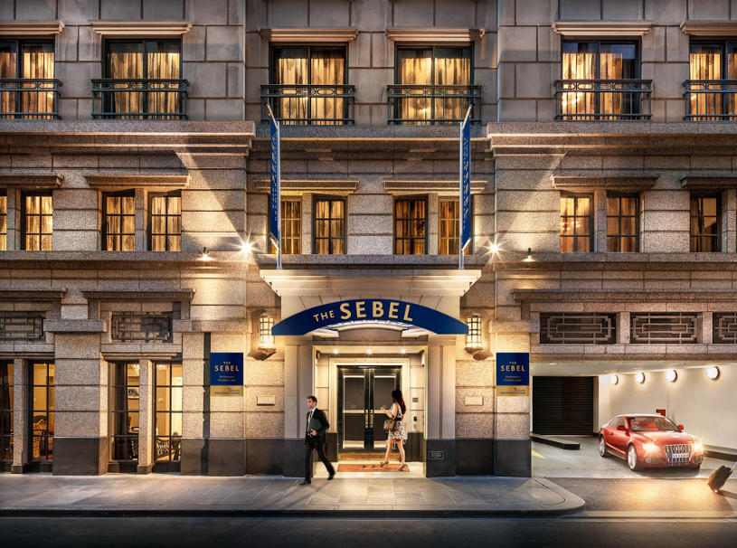
Notes:
x

Slide 2
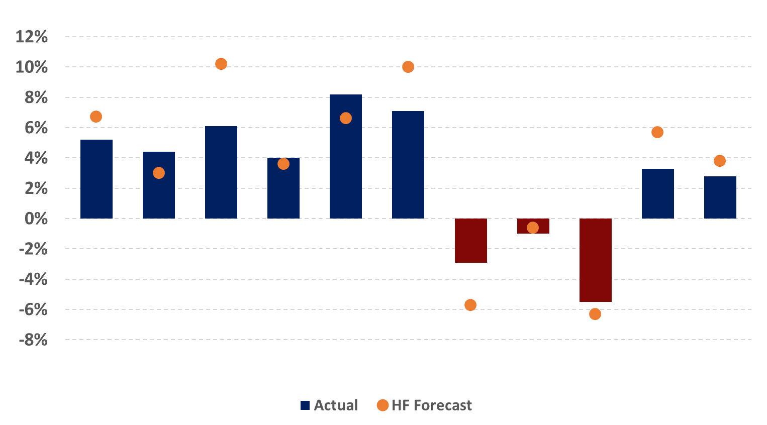
FY2018 Actual Vs Forecast
Source: Dransfield Hotel Futures 2018
Melbourne
Hobart
Perth
Adelaide
Brisbane
Darwin
Sydney
Canberra
Gold Coast
Australia
Cairns & P.D
Notes:
Australia: Overall, Australian major city maintained occupancy levels at a high 80%, enabling rate growth opportunities, which are taken, growing at around inflation. RevPAR growth of 2.8%, slightly underperformed expectations of 3.8%, largely held back by the Sydney underperformance.
Adelaide: Strong RevPAR growth of 5.2% driven by rate (3.6%) as occupancy levels improved 1.1%, however, slightly underperformed strong expectations of 6.7%
Brisbane: Brisbane ushered in another solid year of supply (7% for the second consecutive year) but was still able to post strong RevPAR growth of 4.4%. Demand was strong with occupancy levels improving 2.3 points to 75%
Cairns: Cairns & PD continues to prosper recording 6.0% RevPAR growth following 4 years of average double digit growth. Rate growth was the primary driver this year as Australian leisure markets excel on the back of the lower AUD & Australians decisions to holiday internationally.
Canberra: Canberra continued to post healthy performance with RevPAR growing 4.0%, in line with expectations. Improvements was in both rate 2.3% an occupancy 2 points.
Darwin: Darwin briefly stopped the flow of decline, posting an 8.4% recovery in FY2018 as occupancy improved 5 points to 75%, seemingly the last burst of LNG related activity, however we will speak more about this later.
Gold Coast: As expected the commonwealth games drove strong RevPAR performance on the GC, improving 7.5%. Expectations were slightly higher as the demand dynamics didn’t quite line up to forecasts with occupancy levels topping out at 73% for the full year, almost 2 points behind expectations
Hobart: Small market volatility displayed as circa 500 new rooms (14% supply increase) resulted in a 4 point drop in occ. Despite this rates actually improved as the quality of stock and leisure driver aspect improve all in all, Hobart outperformed poor expectations, with lesser RevPAR decline than expected.
Melbourne: as expected, Melbourne recorded a slight RevPAR decline of 1% as the timing of new opening a affected short term absorption. Occupancy levels continue to hover around to 84-85% market wide meaning limited opportunity for significant demand growth.
Perth: Perth RevPAR declined 6%, inline with expectations as new supply conceived though the boom enters. Demand has continued to show growth largely absorbing the bulk of the new room, however discounting behaviour has been presentations hoteliers lower to maintain market share.
Sydney: Sydney grew 3.3% which was below strong expectations for 5.7% growth. The extreme occupancy levels, of circa 88% essentially means the city is at capacity with many hotels only able to offer single night rooms in some cases. At this occupancy level, rates have significantly prosperity to grow, however they have not which is more to do with hoteliers behaviour rather than pure market dynamics.

Slide 3
FY2018 Actual Vs Forecast
Source: Dransfield Hotel Futures 2018
Melbourne
Hobart
Perth
Adelaide
Brisbane
Darwin
Sydney
Canberra
Gold Coast
Australia
Cairns & P.D
Notes:
Australia: Overall, Australian major city maintained occupancy levels at a high 80%, enabling rate growth opportunities, which are taken, growing at around inflation. RevPAR growth of 2.8%, slightly underperformed expectations of 3.8%, largely held back by the Sydney underperformance.
Adelaide: Strong RevPAR growth of 5.2% driven by rate (3.6%) as occupancy levels improved 1.1%, however, slightly underperformed strong expectations of 6.7%
Brisbane: Brisbane ushered in another solid year of supply (7% for the second consecutive year) but was still able to post strong RevPAR growth of 4.4%. Demand was strong with occupancy levels improving 2.3 points to 75%
Cairns: Cairns & PD continues to prosper recording 6.0% RevPAR growth following 4 years of average double digit growth. Rate growth was the primary driver this year as Australian leisure markets excel on the back of the lower AUD & Australians decisions to holiday internationally.
Canberra: Canberra continued to post healthy performance with RevPAR growing 4.0%, in line with expectations. Improvements was in both rate 2.3% an occupancy 2 points.
Darwin: Darwin briefly stopped the flow of decline, posting an 8.4% recovery in FY2018 as occupancy improved 5 points to 75%, seemingly the last burst of LNG related activity, however we will speak more about this later.
Gold Coast: As expected the commonwealth games drove strong RevPAR performance on the GC, improving 7.5%. Expectations were slightly higher as the demand dynamics didn’t quite line up to forecasts with occupancy levels topping out at 73% for the full year, almost 2 points behind expectations
Hobart: Small market volatility displayed as circa 500 new rooms (14% supply increase) resulted in a 4 point drop in occ. Despite this rates actually improved as the quality of stock and leisure driver aspect improve all in all, Hobart outperformed poor expectations, with lesser RevPAR decline than expected.
Melbourne: as expected, Melbourne recorded a slight RevPAR decline of 1% as the timing of new opening a affected short term absorption. Occupancy levels continue to hover around to 84-85% market wide meaning limited opportunity for significant demand growth.
Perth: Perth RevPAR declined 6%, inline with expectations as new supply conceived though the boom enters. Demand has continued to show growth largely absorbing the bulk of the new room, however discounting behaviour has been presentations hoteliers lower to maintain market share.
Sydney: Sydney grew 3.3% which was below strong expectations for 5.7% growth. The extreme occupancy levels, of circa 88% essentially means the city is at capacity with many hotels only able to offer single night rooms in some cases. At this occupancy level, rates have significantly prosperity to grow, however they have not which is more to do with hoteliers behaviour rather than pure market dynamics.

Slide 4
Major City RevPAR Performance
FY2018 Actual vs forecast
Major City Actual Average RevPAR Growth
Location | Actual FY2018 | HF Forecast FY2018 | Expectation Variance
Adelaide | 5.2% | 6.7% | Slight Underperformed
Brisbane | 4.4% | 3.0% | Outperformed
Cairns | 6.1% | 10.2% | Underperformed
Canberra | 4.0% | 3.6% | Inline
Darwin | 8.2% | 6.6% | Outperformed
Gold Coast | 7.1% | 10.0% | Underperformed
Hobart | -2.9% | -5.7% | Outperformed
Melbourne | -1.0% | -0.6% | Inline
Perth | -5.5% | -6.3% | Inline
Sydney | 3.3% | 5.7% | Underperformed
Australia | 2.8% | 3.8% | Underperformed
Source: Dransfield Hotel Futures 2018
Notes:
Australia: Overall, Australian major city maintained occupancy levels at a high 80%, enabling rate growth opportunities, which are taken, growing at around inflation. RevPAR growth of 2.8%, slightly underperformed expectations of 3.8%, largely held back by the Sydney underperformance.
Adelaide: Strong RevPAR growth of 5.2% driven by rate (3.6%) as occupancy levels improved 1.1%, however, slightly underperformed strong expectations of 6.7%
Brisbane: Brisbane ushered in another solid year of supply (7% for the second consecutive year) but was still able to post strong RevPAR growth of 4.4%. Demand was strong with occupancy levels improving 2.3 points to 75%
Cairns: Cairns & PD continues to prosper recording 6.0% RevPAR growth following 4 years of average double digit growth. Rate growth was the primary driver this year as Australian leisure markets excel on the back of the lower AUD & Australians decisions to holiday internationally.
Canberra: Canberra continued to post healthy performance with RevPAR growing 4.0%, in line with expectations. Improvements was in both rate 2.3% an occupancy 2 points.
Darwin: Darwin briefly stopped the flow of decline, posting an 8.4% recovery in FY2018 as occupancy improved 5 points to 75%, seemingly the last burst of LNG related activity, however we will speak more about this later.
Gold Coast: As expected the commonwealth games drove strong RevPAR performance on the GC, improving 7.5%. Expectations were slightly higher as the demand dynamics didn’t quite line up to forecasts with occupancy levels topping out at 73% for the full year, almost 2 points behind expectations
Hobart: Small market volatility displayed as circa 500 new rooms (14% supply increase) resulted in a 4 point drop in occ. Despite this rates actually improved as the quality of stock and leisure driver aspect improve all in all, Hobart outperformed poor expectations, with lesser RevPAR decline than expected.
Melbourne: as expected, Melbourne recorded a slight RevPAR decline of 1% as the timing of new opening a affected short term absorption. Occupancy levels continue to hover around to 84-85% market wide meaning limited opportunity for significant demand growth.
Perth: Perth RevPAR declined 6%, inline with expectations as new supply conceived though the boom enters. Demand has continued to show growth largely absorbing the bulk of the new room, however discounting behaviour has been presentations hoteliers lower to maintain market share.
Sydney: Sydney grew 3.3% which was below strong expectations for 5.7% growth. The extreme occupancy levels, of circa 88% essentially means the city is at capacity with many hotels only able to offer single night rooms in some cases. At this occupancy level, rates have significantly prosperity to grow, however they have not which is more to do with hoteliers behaviour rather than pure market dynamics.

Slide 5
FY2019 YTD December
Major City Actual Average RevPAR Growth
Location | YTD FY2019 | HF Forecast FY2019 | Variance
Adelaide | -2.5% | 2.4% | Underperforming
Brisbane | -6.0% | -2.7% | Underperforming
Cairns | 0.1% | 2.2% | Underperforming
Canberra | 6.4% | 4.4% | Outperforming
Darwin | -14.4% | 5.3% | Underperforming
Gold Coast | 5.4% | -1.5% | Outperforming
Hobart | 8.5% | 3.0% | Outperforming
Melbourne | -0.1% | 3.0% | Underperforming
Perth | -2.9% | -2.4% | Underperforming
Sydney | -2.6% | 6.8% | Underperformed
Australia | -0.8% | 2.8% | Underperformed
Source: Dransfield Hotel Futures 2018
Notes:
All YTD data changed today with the release of the Dec 18 data.

Slide 6
Supply and Demand – Australia
Rooms
Supply Growth
Average 3.9%
Demand Growth
Average 4.1%
Occupancy
Source: Dransfield Hotel Futures 2018
Notes:
Tourism Research Australia’s long term visitor forecast to FY2025 has been slightly upgraded. Average annual growth of 4.1% p.a is expected compared to 3.9% in the prior forecast.
The smaller International visitor night contingent, which made up approximately 44% of total visitor nights in FY2017 has been upgraded, whilst Domestic visitor nights have been slightly downgraded. International visitor nights are expected to eclipse Domestic nights by FY2024.
Hotel Futures 2018’s long term demand forecast is for average growth of 4.1% p.a, which is a moderate upgrade to the previous forecast. Uplift is derived through improved TRA expectations and enabling supply in some key cities
Medium term demand growth is expected to average 4.5% p.a, which is in line with prior forecasts. Demand growth for this period is inline with supply growth expectations. Supply constraints in several cities have limited further growth
Our long term growth forecast is considered to have more upside opportunity than downside risk with supply constraints remaining in some key gateway cities
Short term actuals and forecasts have slightly increased with some earlier than expected arrivals in FY2017 and FY2018, partly residential developments which switched to Hotel late (Melbourne and gold Coast)
Slight delays have eventuated through the medium term, which may slide further pending progression of proposals.

Slide 7
CAPITAL CITY REVPAR Forecasts
Actual
Forecast
Source: Dransfield Hotel Futures 2018
Notes:
With long term RevPAR growth rates of 4.4%, Sydney will extend its position as the nation leader, realising rate growth opportunities present in the ultra high occupancy environment, carrying the national average upwards
With long term RevPAR growth rates of 3.1%, Melbourne which traditionally sat well above the national average will come back towards the national line with consistent supply additions, including shadow stock, softening the rate outlook. Melbourne, however, still sits well above every other market and is not at risk of losing second position
With long term growth rate of (4.8%),Brisbane and (2.7%) Perth will track parallel to each other over the long term as they both look to absorb considerable medium term supply which was conceptualised through the mining boom. Outlook for both cities is good in the long run

Slide 8
CAPITAL CITY REVPAR Forecasts
Actual
Forecast
Source: Dransfield Hotel Futures 2018
Notes:
-With RevPAR growth rates of (3,4%) Adelaide, (3,4%) Canberra and (1.4%) Hobart are expected to travel along similar curves as hotel cities expand their leisure and events demand drivers, and start to welcome additional supply which has been largely dormant historically

Slide 9
Capital CITY REVPAR forecasts
Actual
Forecast
Source: Dransfield Hotel Futures 2018
Source: Dransfield Hotel Futures 2018
Notes:
With RevPAR growth rates of 4.3%, Darwin begins to gain on (3.4%) Cairns as the reset of corporate contracts ends and supply development remains low, whilst Cairns recent outperformance starts to normalize
RevPAR growth of 3.8% for Gold Coast is strong and above both Cairns and Darwin for the life of the forecast. This is partly associated to the cycle each city is in with Gold Coast yet to experience the next wave of considerable supply

Slide 10
Major City RevPAR Forecast
Medium and long term
forecast Per Annum
Forecast Average RevPAR Growth p.a.
Location | Medium Term 3 Years to FY2020 | Long Term 9 Years to FY2026 | Upgrade/ Downgrade
Adelaide | 4.5% | 3.4% | Inline
Brisbane | 1.4% | 4.8% | Upgraded
Cairns | 4.3% | 3.4% | Downgraded
Canberra | 4.0% | 3.4% | Downgraded
Darwin | 5.9% | 4.3% | Inline
Gold Coast | 3.6% | 3.8% | Inline
Hobart | -1.8% | 1.5% | Inline
Melbourne | 1.0% | 3.1% | Downgraded
Perth | -4.1% | 2.7% | Inline
Sydney | 5.8% | 4.4% | Inline
Australia | 3.1% | 4.0% | Inline
Source: Dransfield Hotel Futures 2018
Notes:
Australia:
Adelaide:
Brisbane:
Cairns:
Canberra:
Darwin:
Gold Coast:
Hobart:
Melbourne:
Perth:
Sydney:

Slide 11
New Zealand Performance
 | ???? – ???? Growth + actuals
Location | Rate | Growth | Occupancy | Growth | RevPAR | Growth
Auckland | $207.54 | 0.4% | 82.3% | -0.7% | $170.73 | -0.4%
Queenstown | $247.33 | 8.3% | 83.6% | -0.3% | $206.67 | 7.9%
Rotorua | $142.34 | 7.1% | 78.6% | -1.1% | $111.90 | 5.9%
Christchurch | $155.49 | 2.5% | 78.0% | 3.8% | $155.49 | 6.4%
Wellington Area | $182.31 | -1.0% | 78.3% | -0.2% | $182.31 | -1.2%
Source: STR
Notes:
xxx

